Slide 1
INTRODUCTION TO ARDUINO

Slide 2
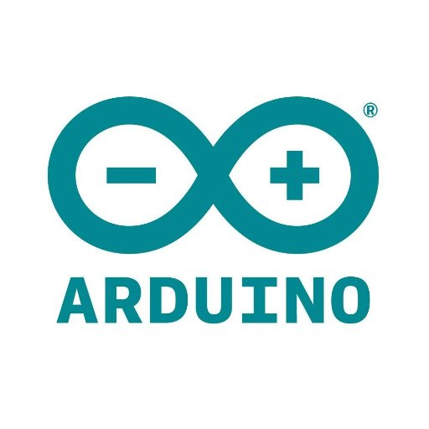
CONTENTS
What is an Arduino?
History of Arduino
What is an Open Source Microcontroller Platform?
Difference Between Microcontroller and Microprocessor.
Why Arduino?
Applications of Arduino.

Slide 3
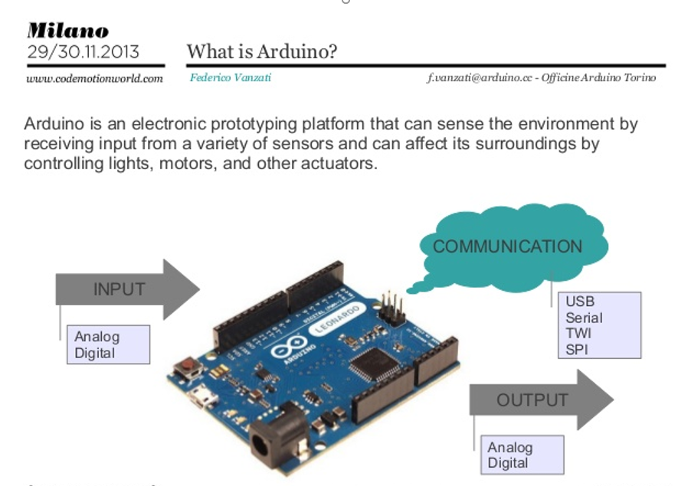
WHAT IS AN ARDUINO?

Slide 4
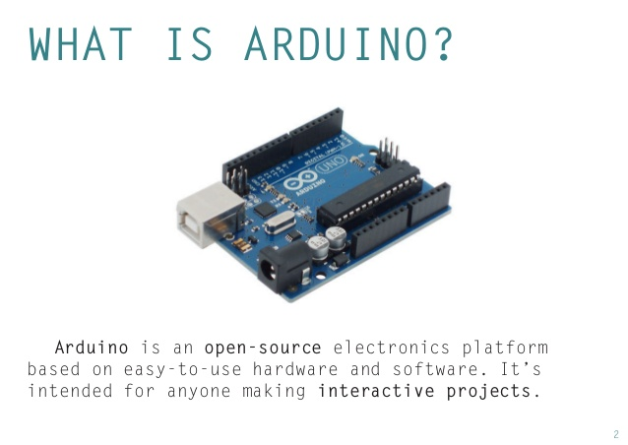
WHAT IS AN ARDUINO?

Slide 5
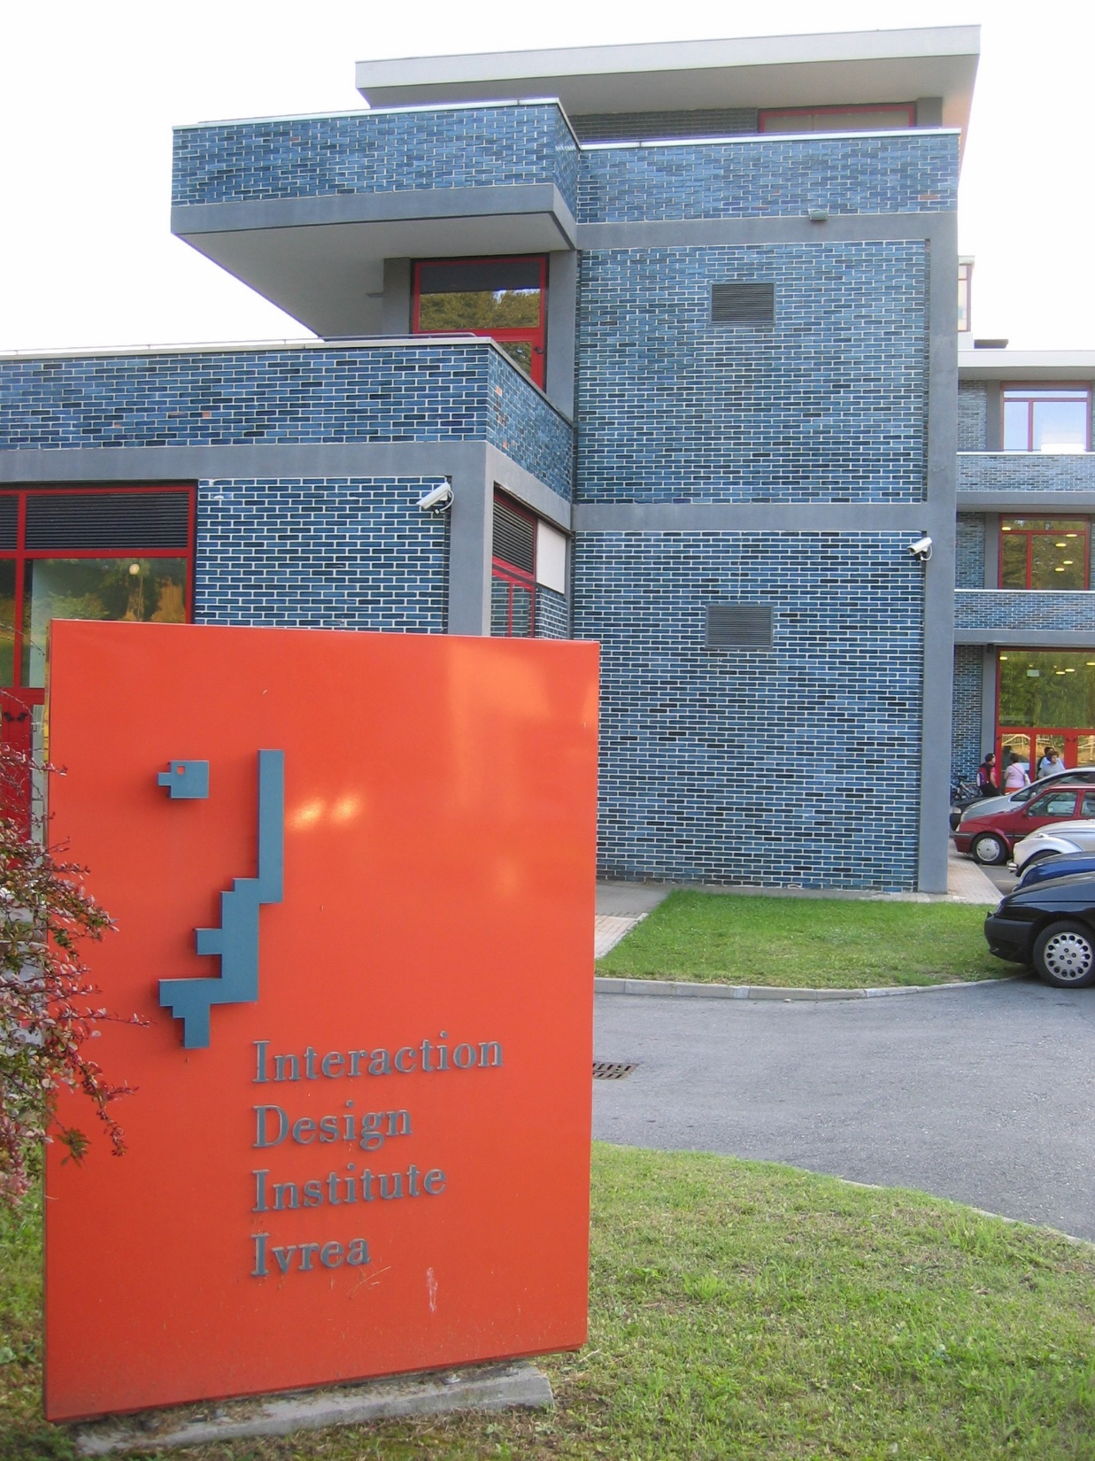
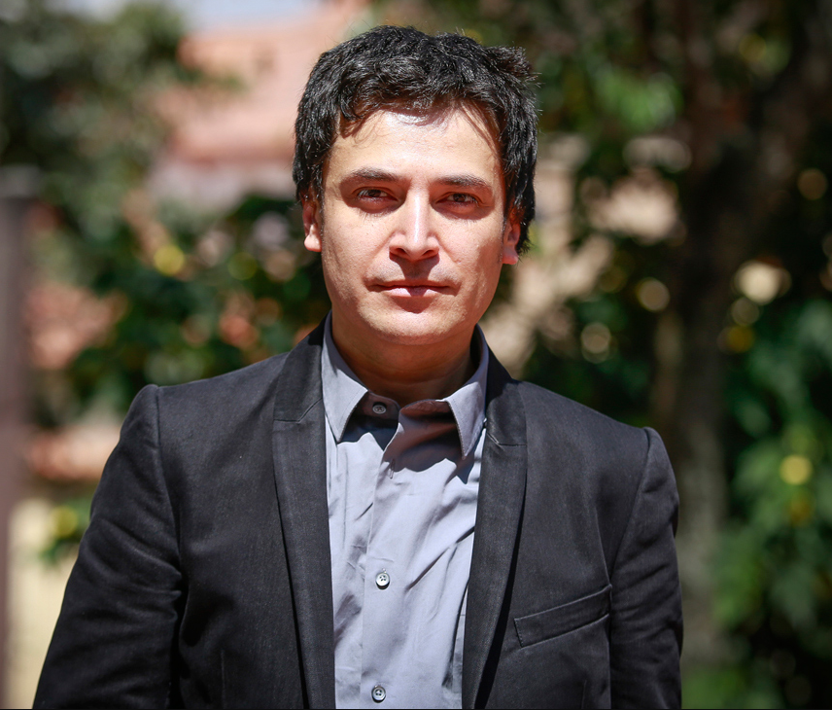
HISTORY OF ARDUINO
The Arduino project started at the Interaction Design Institute Ivrea (IDII) in Ivrea , Italy.

Slide 6
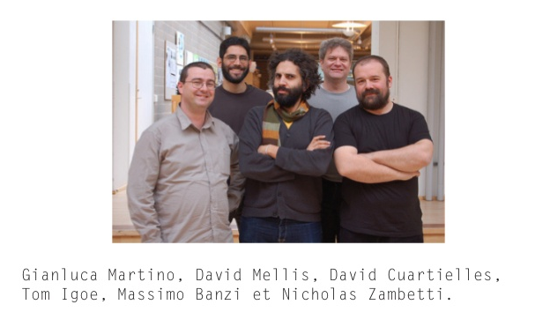
HISTORY OF ARDUINO
In 2003 Hernando Barragán created the development platform Wiring as a Master's thesis project at IDII, under the supervision of Massimo Banzi and Casey Reas, who are known for work on the Processing language.

Slide 7
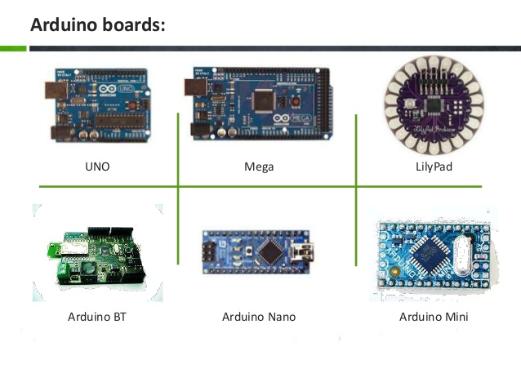
Versions of ARDUINO

Slide 8
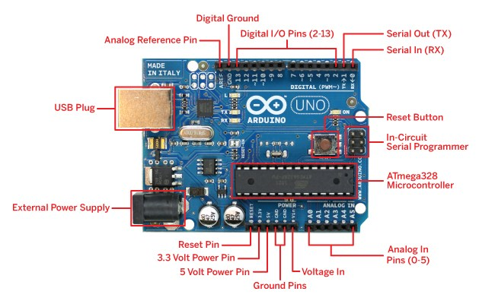
ARDUINO Uno

Slide 9
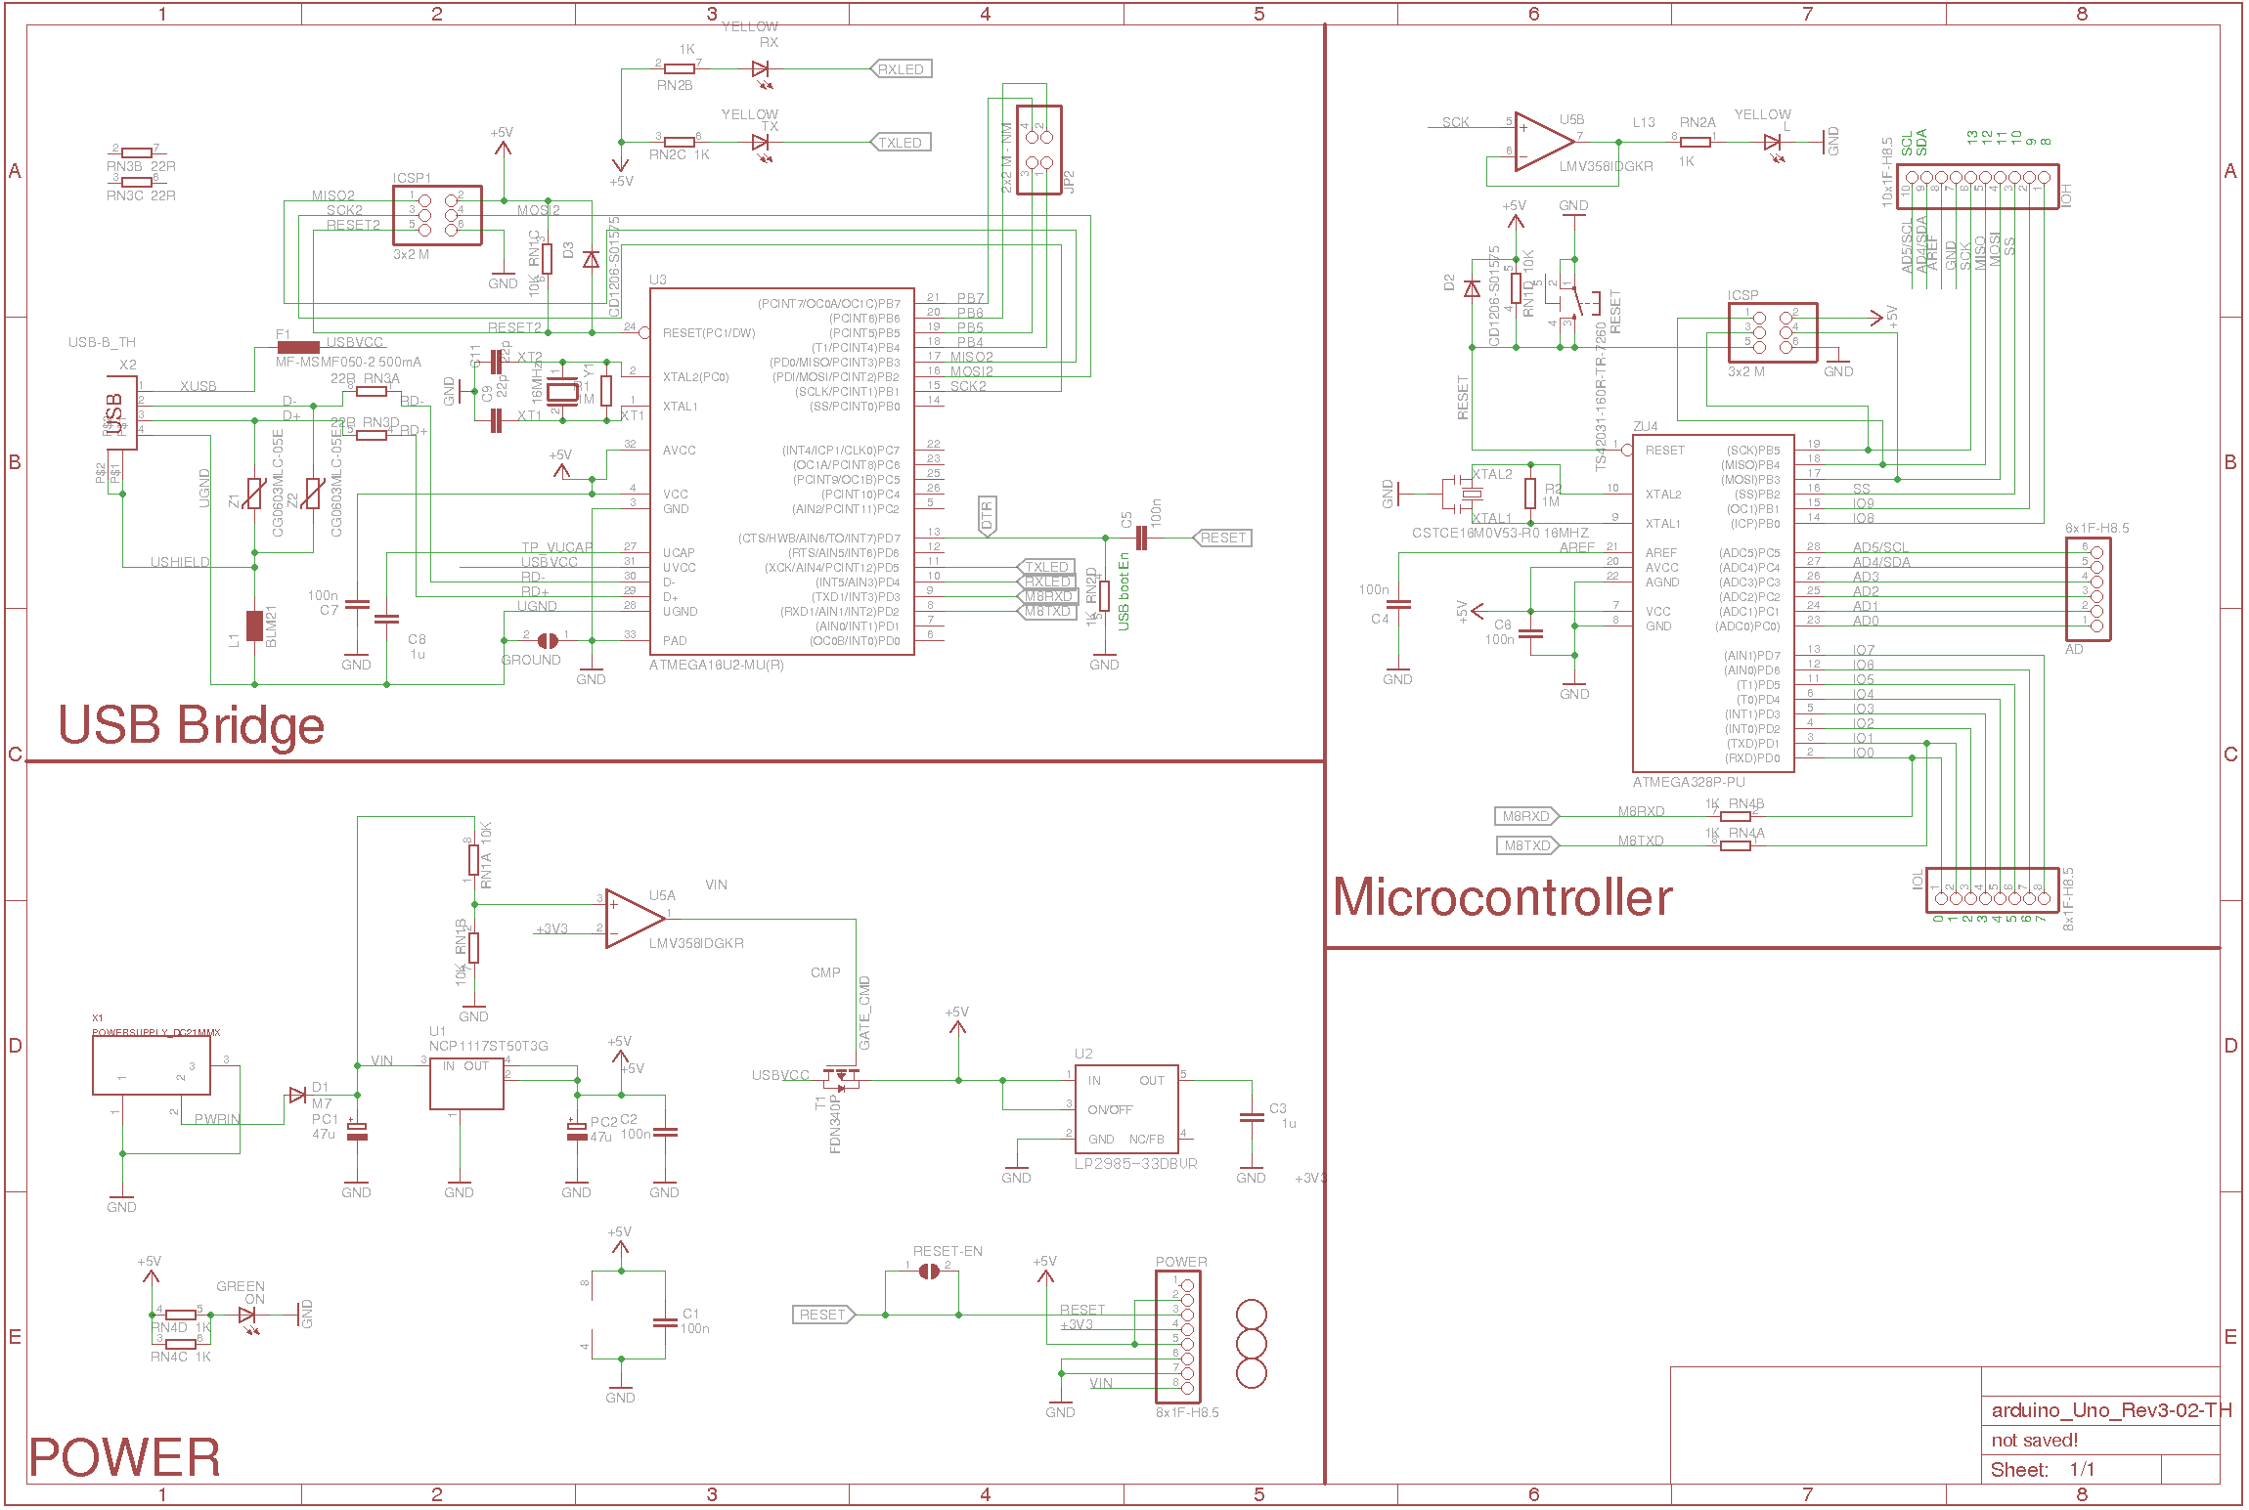
OPEN SOURCE

Slide 10
DIFFERENCE BETWEEN MICROCONTROLLER AND MICROPROCESSOR

Slide 11
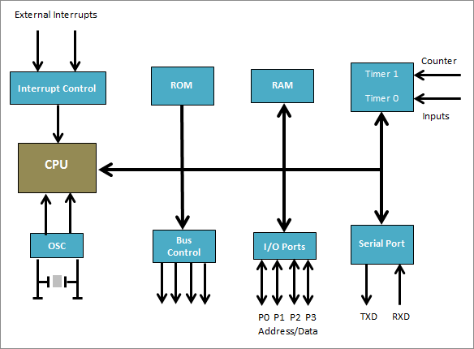
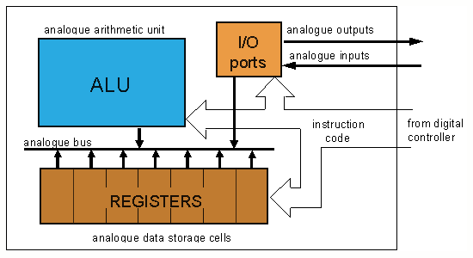
MICROCONTROLLER
MICROPROCESSOR

Slide 12
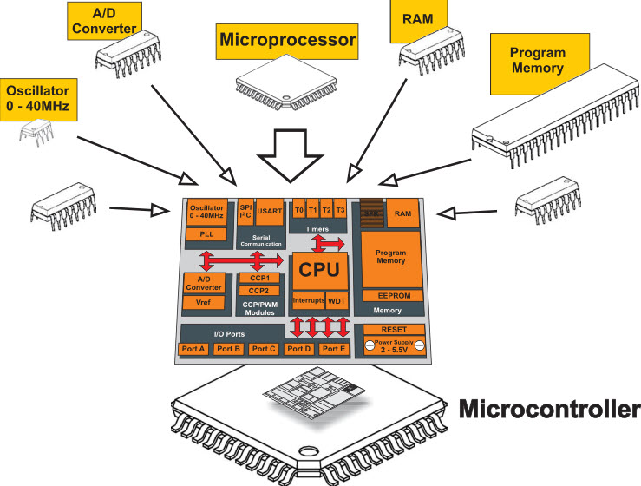

Slide 13

WHY ARDUINO?
Cheap hardware for prototyping
Fast plug and play for projects
Compatible with most electronics
Opens a world for innovation
Easy to use. Easy to learn
More reliable than other Microcontrollers

Slide 14
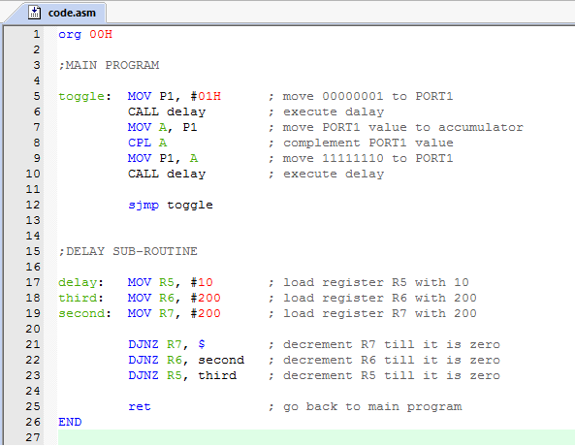
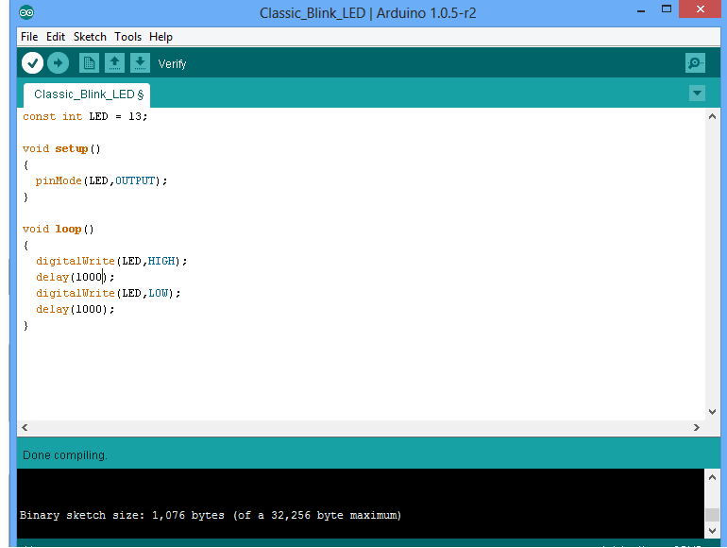
WHY ARDUINO?

Slide 15
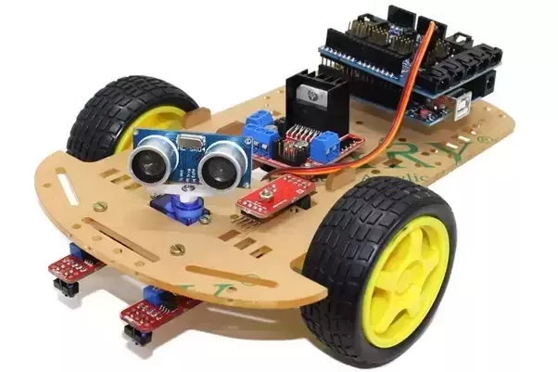
APPLICATIONS OF ARDUINO
Traffic Light Count Down Timer
Parking Lot Counter
Weighing Machines
Medical Instrument
Emergency Light for Railways
ESP 8266 Wi-Fi module based appliances control
GSM based Farm motor controlling.
Android phone controlled robo car.
Water level indicator.
Robotics and Control Systems

Slide 16
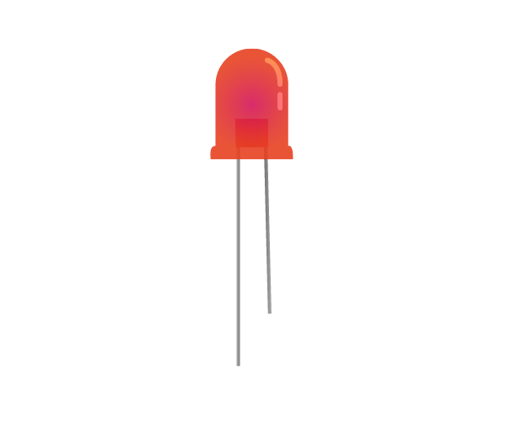
Interfacing LED with Arduino

Slide 17
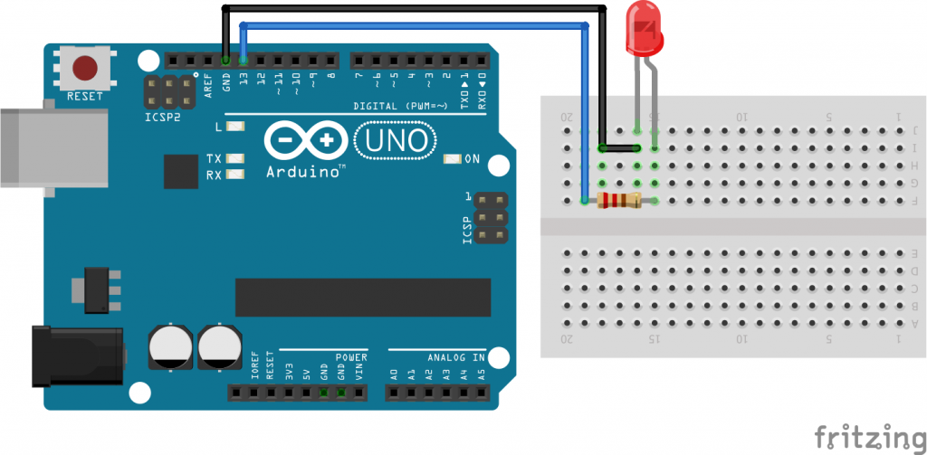

Slide 19
LED Patterns with Arduino

Slide 20
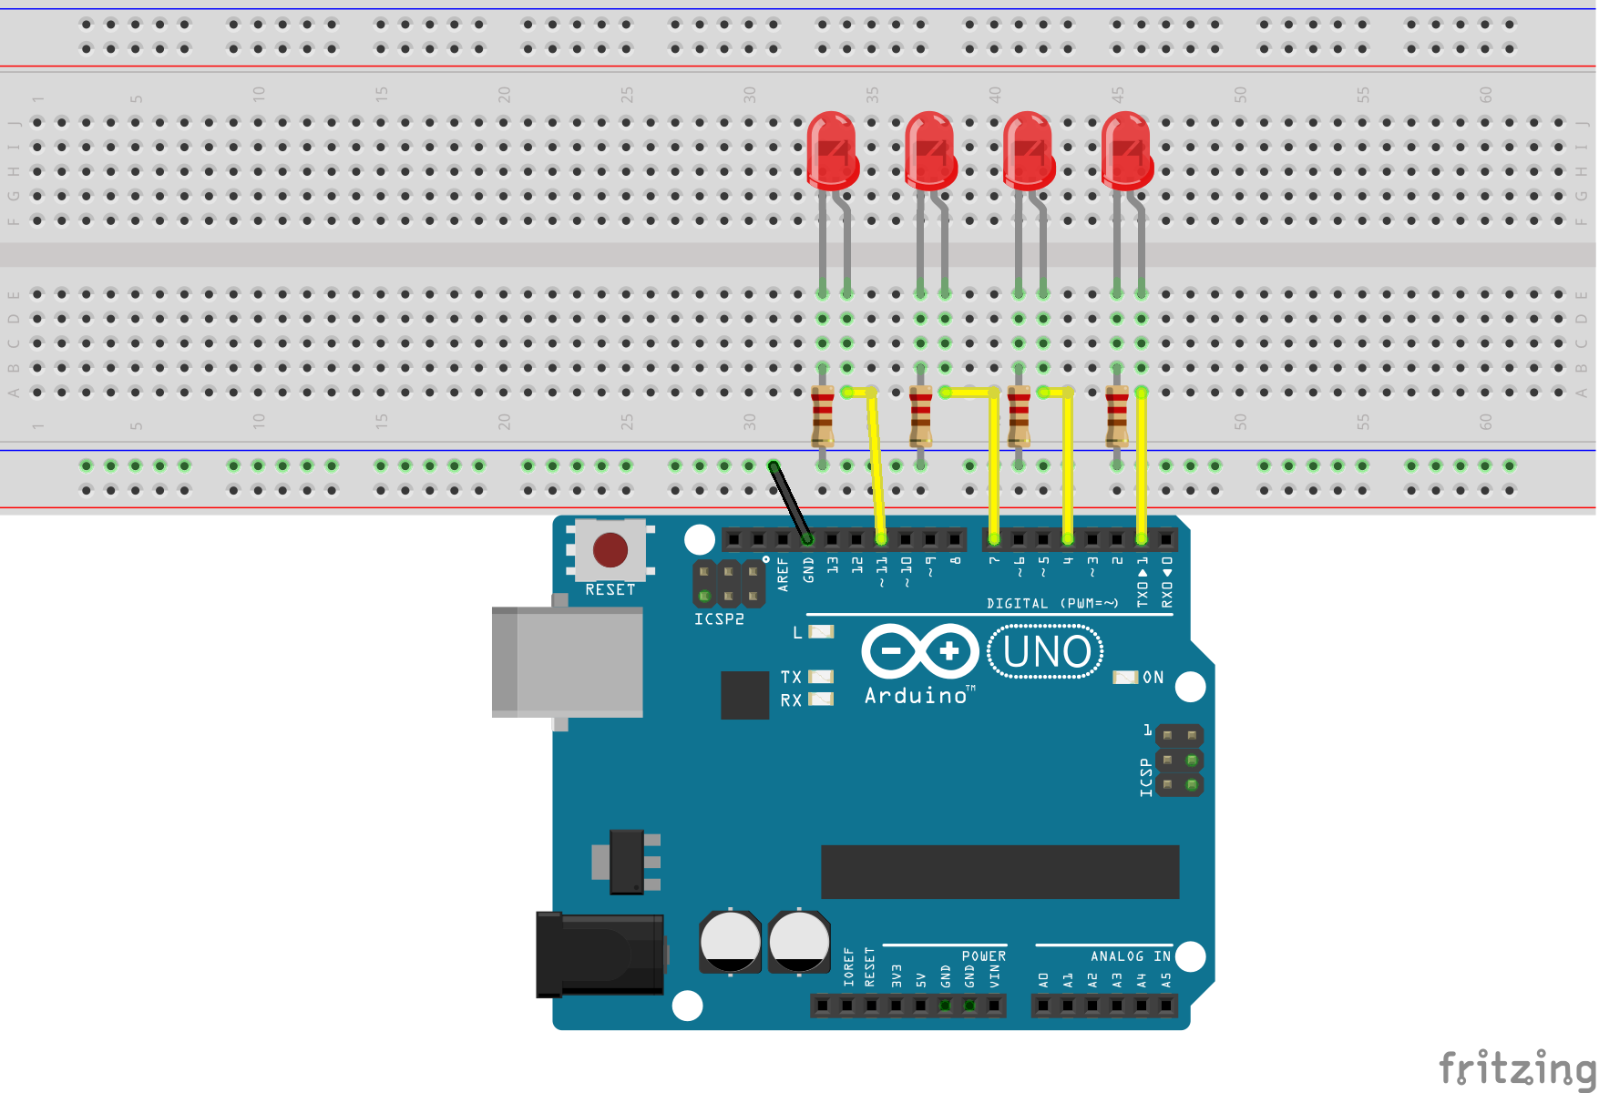

Slide 21
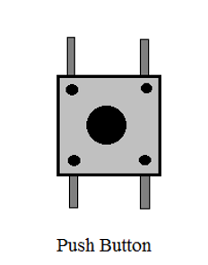
Interfacing Push Button with Arduino

Slide 22
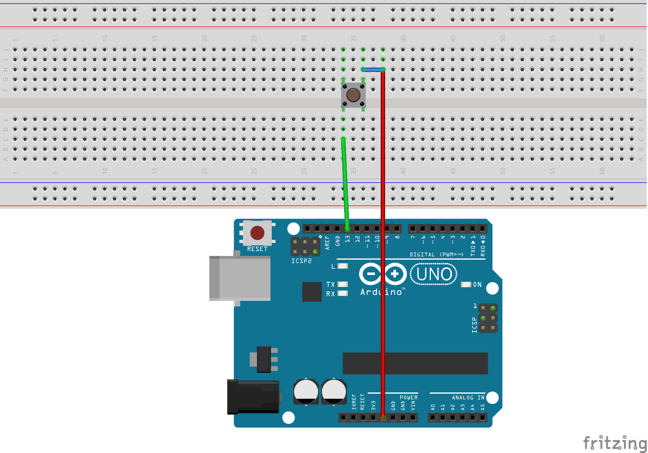

Slide 23
Controlling LED through Push Button Sensor

Slide 24
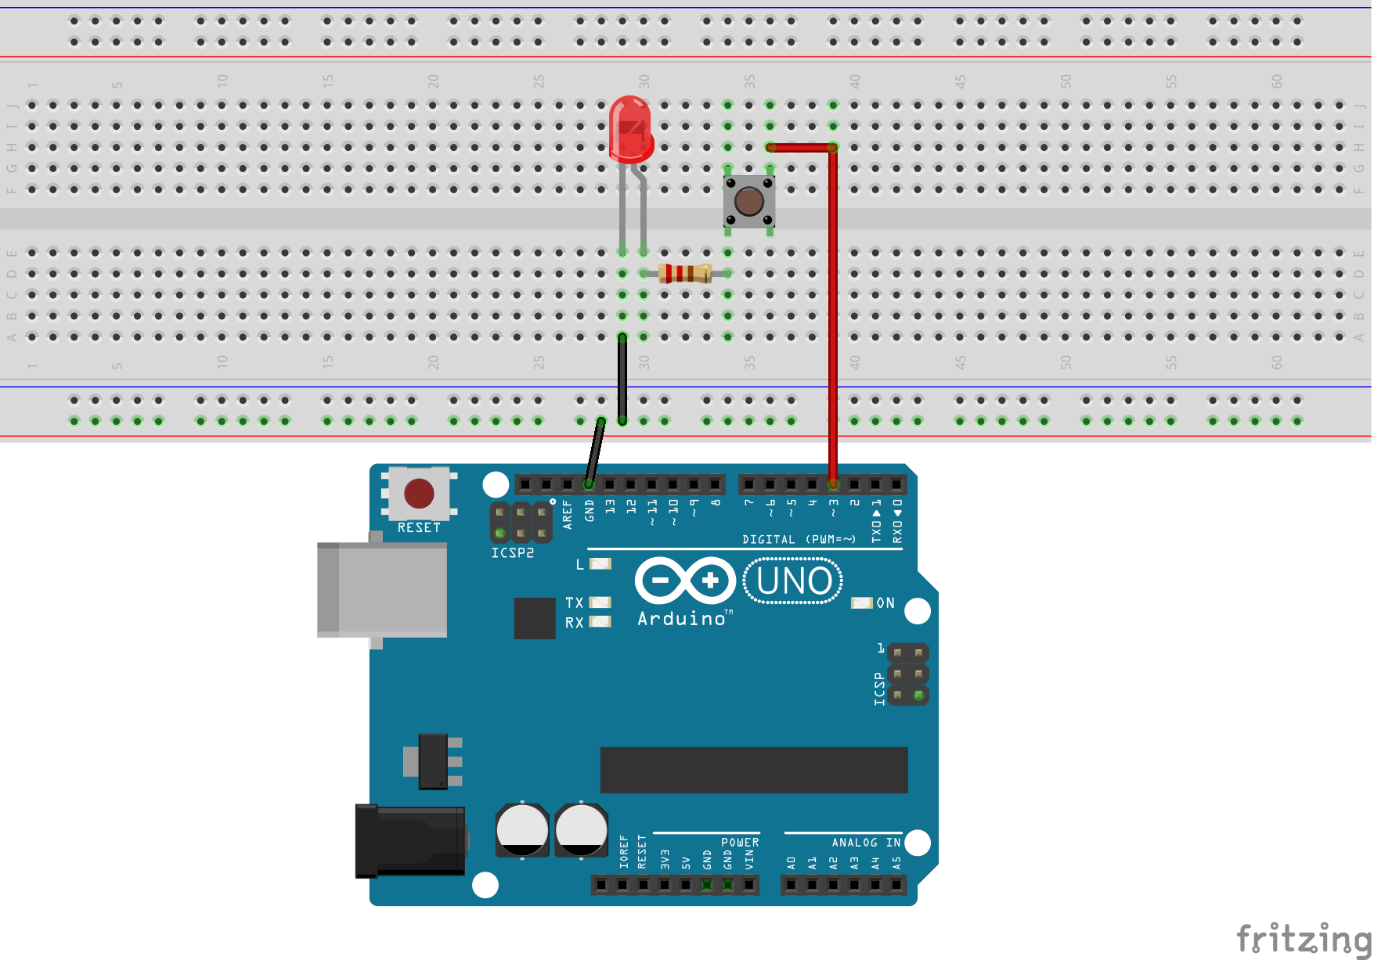

Slide 25
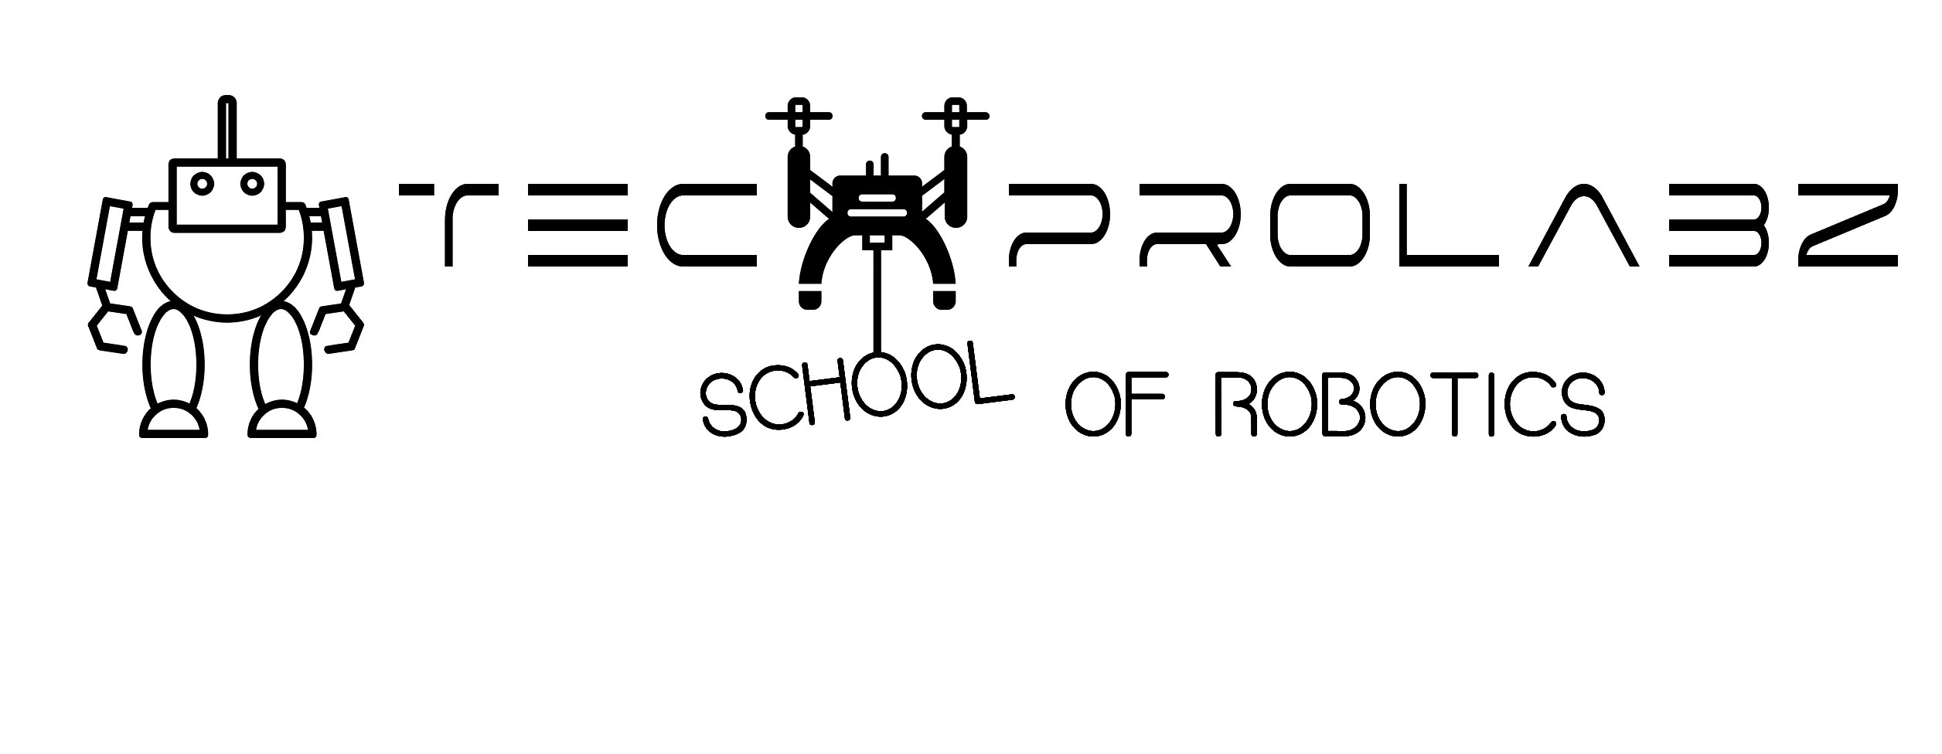
THANK YOU

